Slide 1
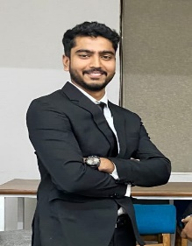

UN SDGs Adopted
Name of the SSO Udayan Care
Utkarsh Anand PGDM Batch 2024-26
List of Activities at the SSO:
Educational Support: Helped children with homework, provided tutoring in challenging subjects, and encouraged academic growth.
Recreational Activities: Organized games, art sessions, and creative activities to foster teamwork and joy.
Administrative Tasks: Managed documentation, added children’s names to government databases, and assisted in creating and updating identification documents such as PAN cards and Aadhaar cards.
Details of the Intellectual Outcome:
Boosted Confidence: Fun activities like games and art sessions helped in building children’s confidence by encouraging their creativity and social skills.
Teamwork and Emotional Well-being: Organizing team-based recreational activities fostered a sense of teamwork and contributed positively to their emotional and mental well-being.
Administrative Efficiency: Managing documents and assisting with identification processes such as PAN cards and Aadhaar cards streamlined their access to important services.
SECTION-C
24PGDM146
UTKARSH ANAND

Slide 2
